Slide 2
Recap!
Computing
Fields of Discipline
Computing Domains
Knowledge Areas in Computing (next)

Slide 3
Computing
Domains
Algorithm
Computer Theory
Cryptography
Distributed Computing
Cloud Computing
Machine Learning / Computational Learning
Big Data
Computer Vision
Neural Network
Platform Technologies
Cybersecurity
User Interface Design
These are specific, specialized discipline or field in computing.

Slide 4
Computing Domains
Algorithms
Algorithms are an explicitly described method for solving a problem.
Computer Theory
is the branch of computer science concerned with finding out how efficiently a given problem can be solved on a model computer using a given algorithm.

Slide 5
Computing Domains
Cryptography
Cryptography is an ancient science concerned with secret writing.
In the modern context of computers, cryptography is the science of encrypting data.
Big Data
It is the collection and analysis of large amounts of data. It is usually associated with large Internet companies such as Facebook and Google.

Slide 6
Computing Domains
Distributed Computing
Distributed computing is a means of breaking up a complex problem, distributing the pieces to various computers across a network (usually the Internet), and having them work on the problem concurrently until the problem is solved.
Platform Technologies
A Platform is a group of technologies that are used as a base upon which other applications, processes, or technologies are developed.

Slide 7
Computing Domains
Cloud Computing
According to Dikaiakos et. Al [2009] and others, “Cloud computing is a recent trend in IT that moves computing and data away from desktop and portable PCs into large data centers”
It refers to applications delivered as services over the Internet as well as to the actual cloud infrastructure — namely, the hardware and systems software in data centers that provide these services

Slide 8
Computing Domains
Computational Learning / Machine Learning
Computational learning, more commonly referred to as machine learning is a sub-field of artificial intelligence.
It is dedicated to the design and development of algorithms and techniques that allow computers to ‘learn’.
Cybersecurity
Cybersecurity is the practice of protecting systems, networks, and programs from digital attacks.

Slide 9
Computing Domains
Computer Vision
Computer vision is the field of computer science in which the goal is to process video or still images and produce from them a representation of the world. This entails things such as recognition of objects, gestures, and motion.
User Interface Design
User Interface (UI) Design is the process of making interfaces in software or computerized devices with a focus on looks or style

Slide 10
Computing Domains
Neural Networks
Neural networks are artificial intelligence agents that simulate biological neuron structures to process inputs and produce outputs. Neural networks are trained on inputs until they recognize patterns and produce useful outputs.

Slide 11
Recap!
Computing
Fields of Discipline
Computing Domains
Knowledge Areas in Computing (next)

Slide 12
Knowledge Area
Information System
Implement Information system
Information Management (Database)
Design a database mgt system
Train Users to use Information Systems
Maintain and Modify Information Systems
Model and design a database
Select database products
Configure Database products
Manage databases
Train and support database users
Implement information retrieval software

Slide 13
Knowledge Area
Networking and communications
Design network configuration
Select network components
Install Computer Network
Manage Computer Networks
Implement Communication software
Manage communication resources
Implement mobile computing system
Manage mobile computing resource
Intelligent System
Design auto reasoning system
Implement Intelligent System

Slide 14
Knowledge Area
Develop corporate information plan
Develop computer resource plan
Schedule/budget resource upgrade
Install / upgrade computers
Install Upgrade Software
System Development through Integration
Manage an organization’s presence
Configure & integrate e-commerce software
Develop multimedia solutions
Configure & integrate e-learning systems
IT resource planning

Slide 15
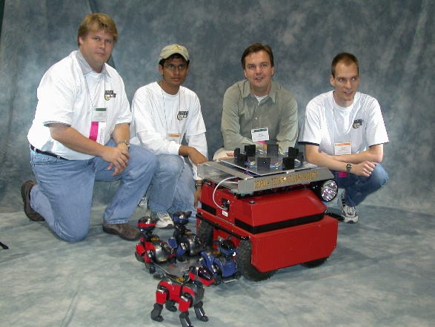
Current Trends in Computing
Robotics Computing
Robotic Computing (RC) addresses the synergetic interaction of computing technologies and robotic technologies. The synergy between Robotics and Computer Science is both realistic and strategic.
Their mutual benefit is to make it possible to build and evolve new robotic systems, to reduce their development cost, and to enhance their quality.

Slide 16
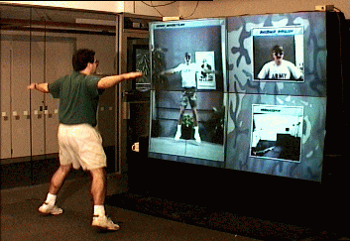
Current Trends in Computing
Computer Vision
Computer vision is a field of computer science that works on enabling computers to see, identify and process images in the same way that human vision does, and then provide appropriate output.
Computer vision is closely linked with artificial intelligence, as the computer must interpret what it sees, and then perform appropriate analysis or act accordingly.

Slide 17
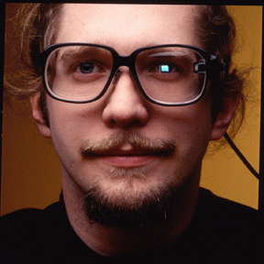
Current Trends in Computing
Wearable Computing
Wearable computing is the study or practice of inventing, designing, building, or using miniature body-borne computational and sensory devices.
The field of wearable computing, however, extends beyond "Smart Clothing". The term "Body-Borne Computing" or "Bearable Computing" is also used as a substitute for "Wearable Computing" so as to include all manner of technology that is on or in the body.

Slide 18
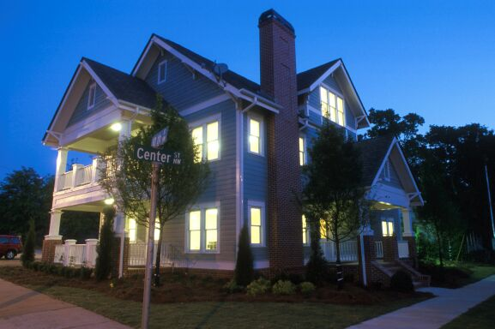
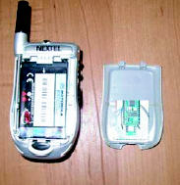
Current Trends in Computing
Ubiquitous Computing
Ubiquitous computing is a paradigm in which the processing of information is linked with each activity or object as encountered.
It involves connecting electronic devices, including embedding microprocessors to communicate information.
Ubiquitous computing is also known as pervasive computing, everyware and ambient intelligence.

Slide 19
REFERENCES
Website:
Fungsi Motherboard Processor Memori Dan Harddisk | Computer hardware, Computer hardware store, Computer Pinterest. https://www.pinterest.ph/pin/88594317657692933/?mt=login
Unit 4 - Hardware & Ergo - Davids BTA30 Portfolio 2016 Sites.google.com. https://sites.google.com/site/davidsbtaportfolio/unit-4---hardware-ergo.
Computer Software Icon #229946 - Free Icons Library. Icon-library.com. https://icon-library.com/icon/computer-software-icon-14.html
https://www.programiz.com/cpp-programming
https://www.rapidtables.com/code/text/ascii-table.html
Timeline of Computing History: https://www.computer.org/cms/Computer.org/Publications/timeline.pdf

Slide 20
REFERENCES
Books:
Computing Essentials 2017 Complete, Timothy O‟Leary & Linda O‟Leary
Discovering Computers Fundamentals 4th Edition, 2008
Gary B. Shelley, Thomas J. Cashman, Misty E. Vermaat
Understanding Computers: Today and Tomorrow Comprehensive 15th Edition Deborah Morley, Charles S. Parker
Computing Curricula 2005 The Overview Report by ACM & IEEE
Information Technology Curricula 2017 by ACM & IEEE-CS
Computer Science Curricula 2013 by ACM & IEEE-CS
10 Domains in Computer Science, Kyle Harrity (September 1, 2013)

Slide 21
--- END ---

